Slide 1
Lingvo Framework

Slide 2
Model basics
A model is defined as a class
Lingvo’s trainer (trainer.py) is used to train these models. (the class is passed as an argument to the trainer)

Slide 3
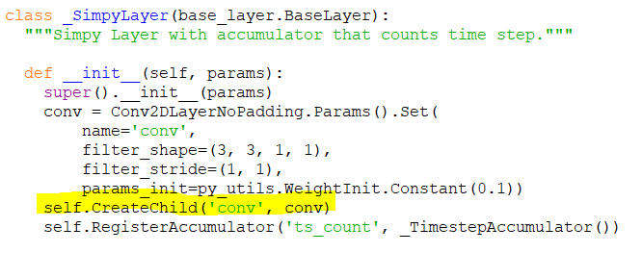
Layer structure of model
Each layer can be composed of multiple child layers.
Here, SimpyLayer consists of a child layer (conv)

Slide 4
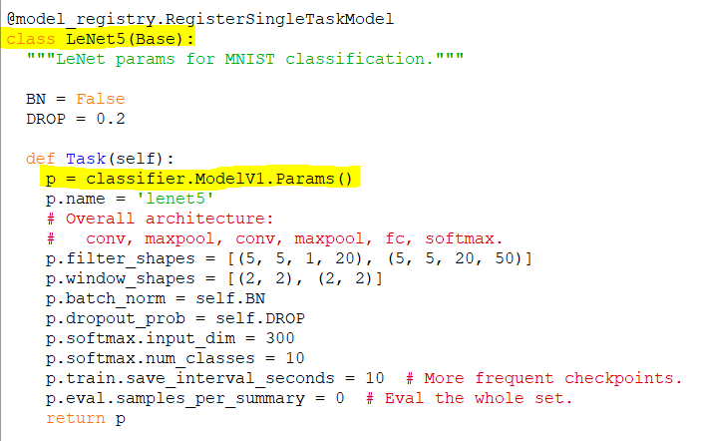
How its structured (contd.)
Case 1: No GPipe (layer creation)
Base Task (Parameter initializations take place here)

Slide 5
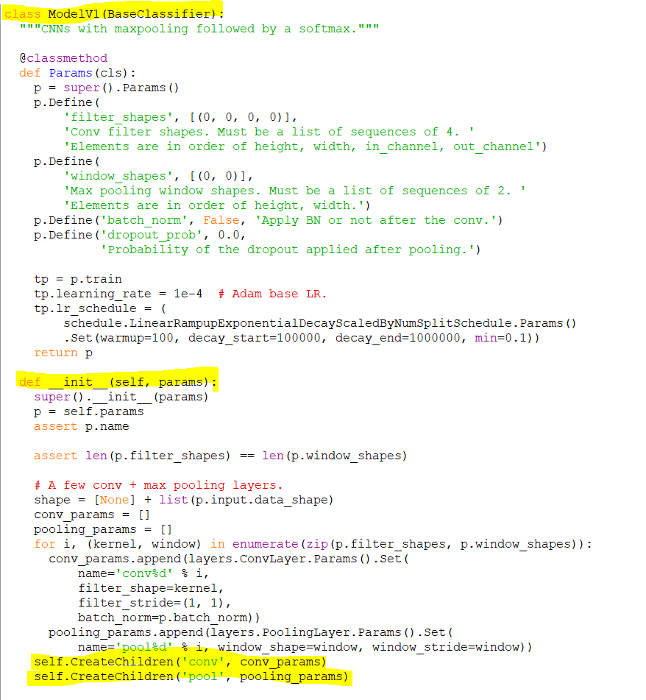
Called after parameters are initialized.
Individual layers with no relation to GPipe

Slide 6
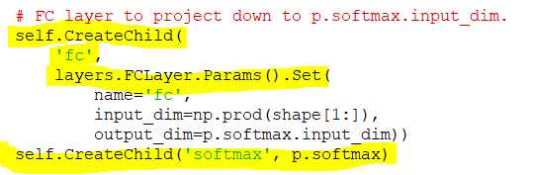
Similarly create FC and Softmax layers

Slide 7
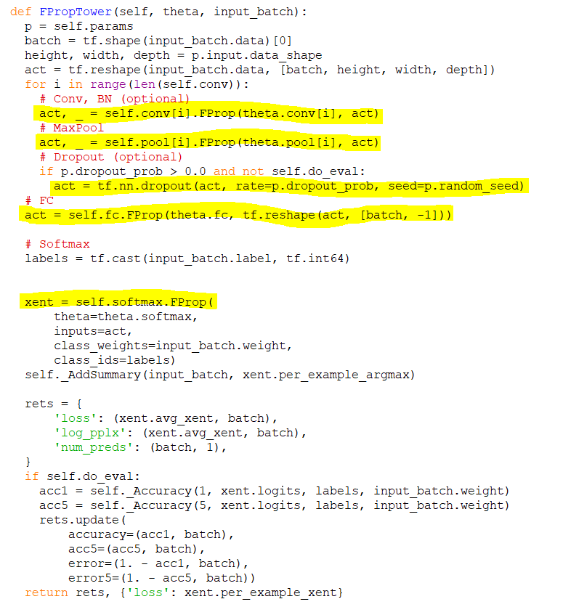
How computation is done without GPipe
Here computation is done without any concern for where a layer is placed. No need to bother with data transfer between different splits explicitly.
Notice that FProp is called for each layer separately

Slide 8
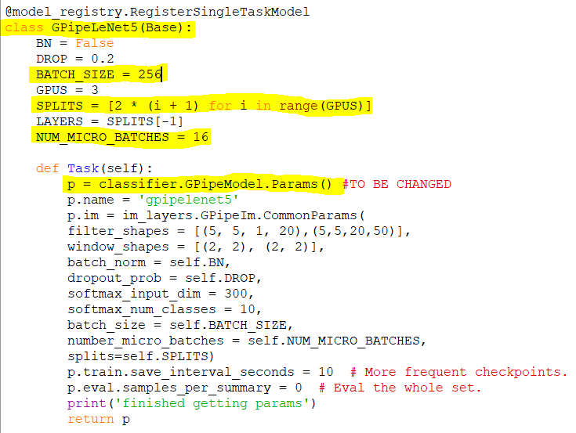
Case 2 (With Gpipe)
Layer creation

Slide 9
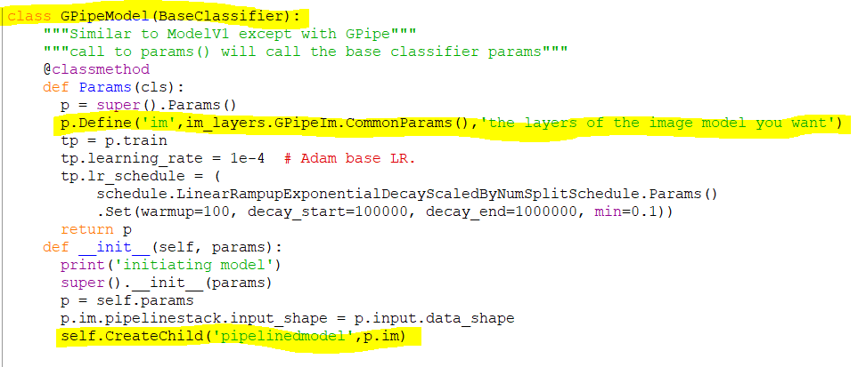
You create the pipelining layer as a child rather than adding each layer as a separate child. The pipelining layer contains all the other layers within it.

Slide 10
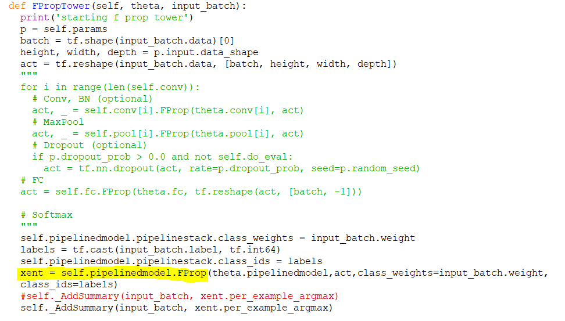
Notice that FProp is called only once here.

Slide 11
Distinction between GPipe and Non-GPipe
Pipelining layer
conv1
conv1
pool1
pool1
conv2
conv2
pool2
pool2
fc1
fc1
sm1
sm1

Slide 12
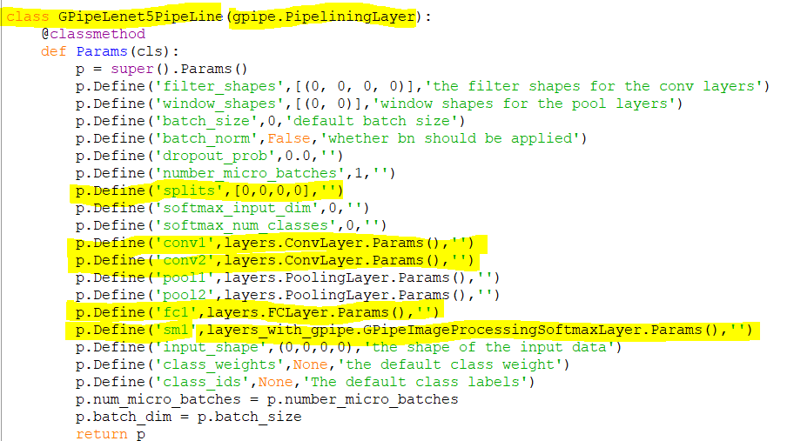
Within the Pipelining Layer
Within the pipelining layer, the parameters for each sub layer is initialized..

Slide 13
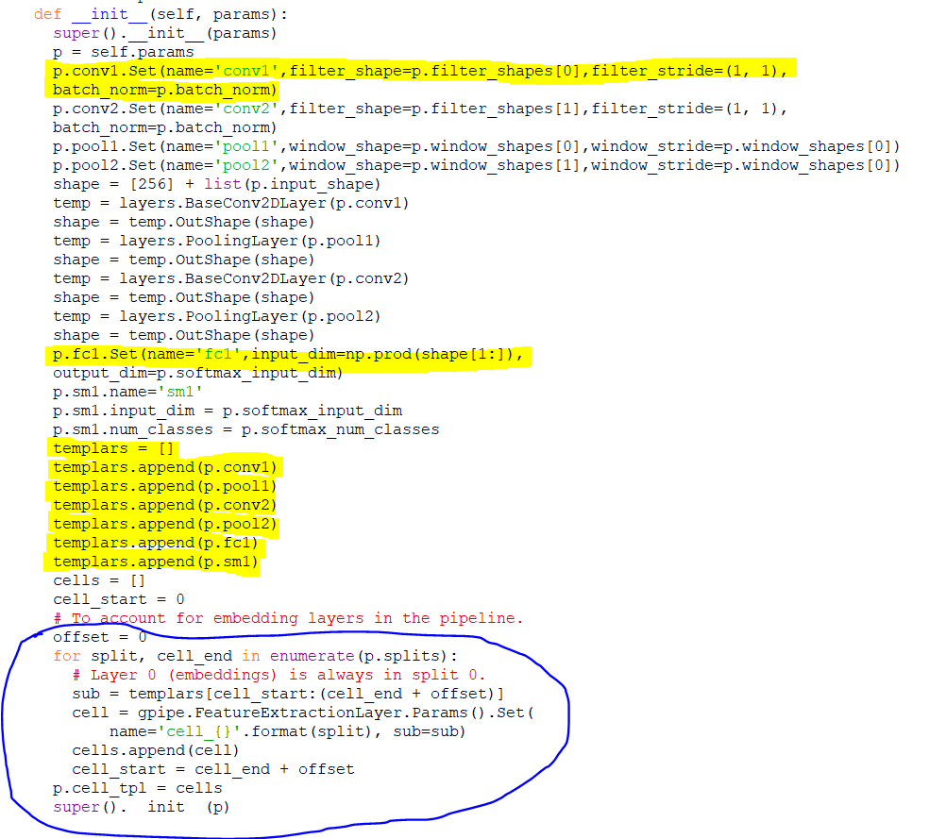
For each split, add a FeatureExtraction layer to handle transfer of info between splits

Slide 14
Illustration of partitioning
conv1
pool1
conv2
Set of layers created
pool2
fc1
sm1

Slide 15
Assume we choose to partition with split sizes of 2 layers each
Split 1
conv1
conv2
fc1
pool2
Split 2
sm1
pool1
Feature Extraction
Split 3

Slide 16
Extending the compatibility of Lingvo with GPipe
Currently, only supports GPipe for transformer layers, convolutional layers without padding, etc. (These can be found in the layers_with_gpipe.py file)
Inclusion for other layers requires implementation of FPropMeta()

Slide 17
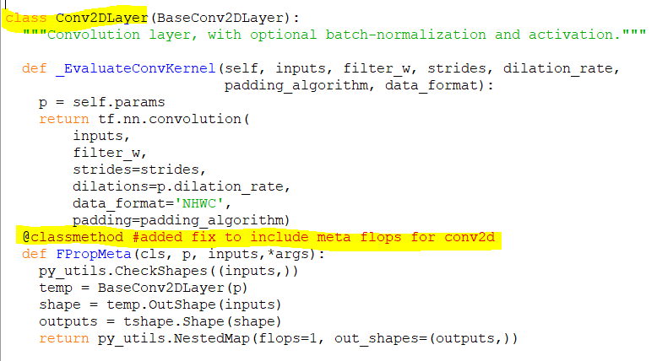
Addition to Conv2D and PoolingLayer

Slide 18
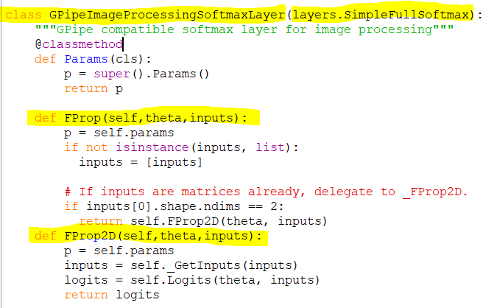
Softmax Layer (Added a GPipe-compatible layer)

Slide 19
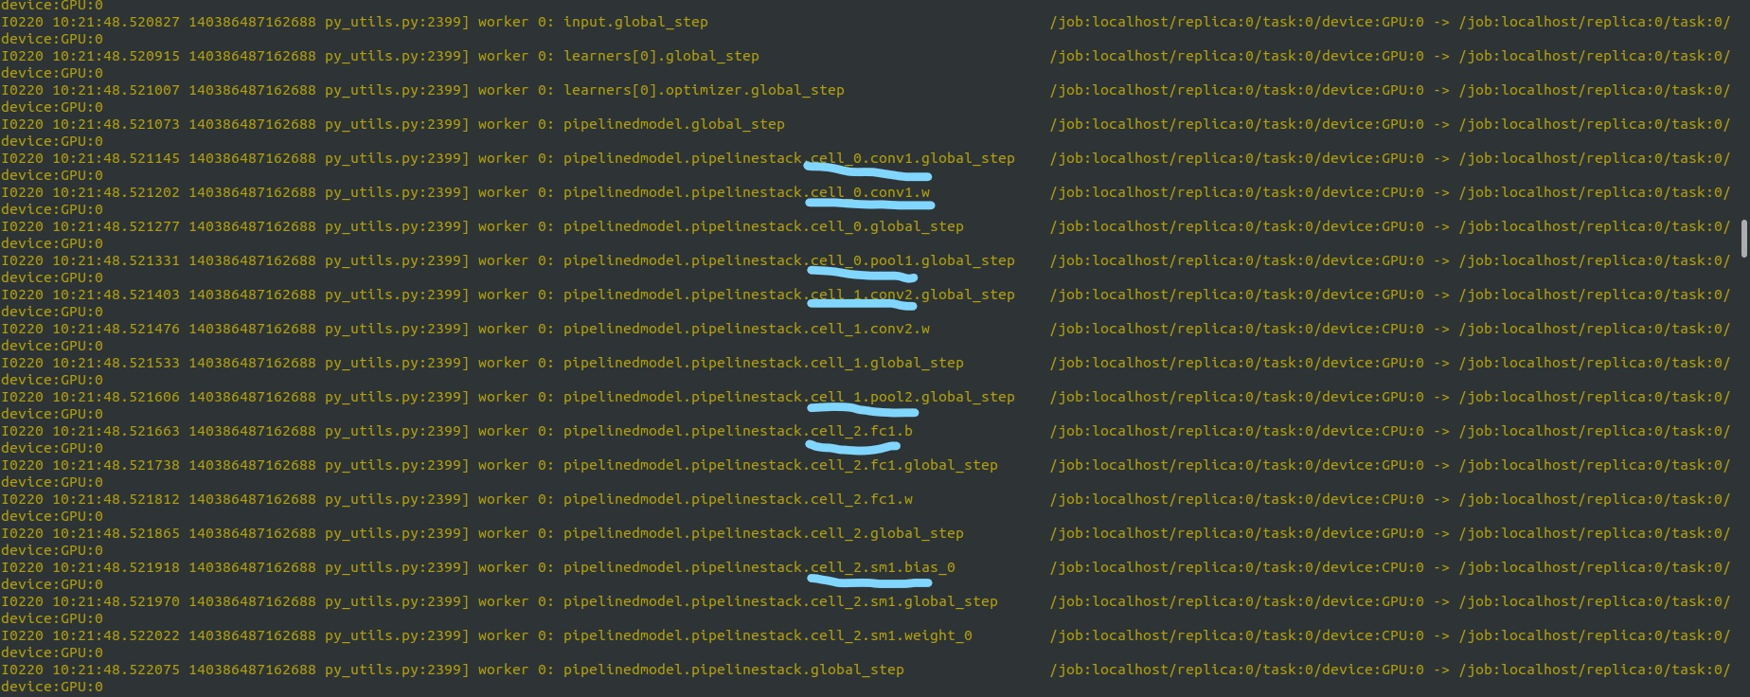
Logs and results
Partitioning

Slide 20
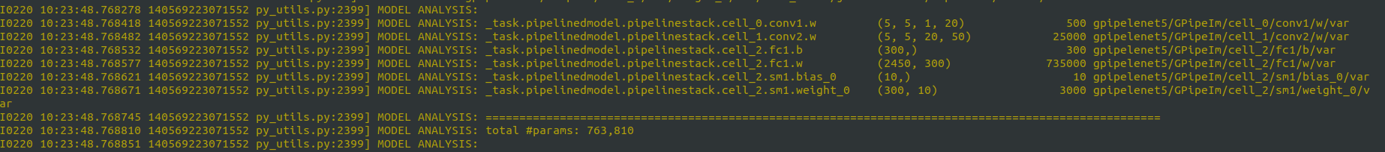
Logs and results
Model details

Slide 21
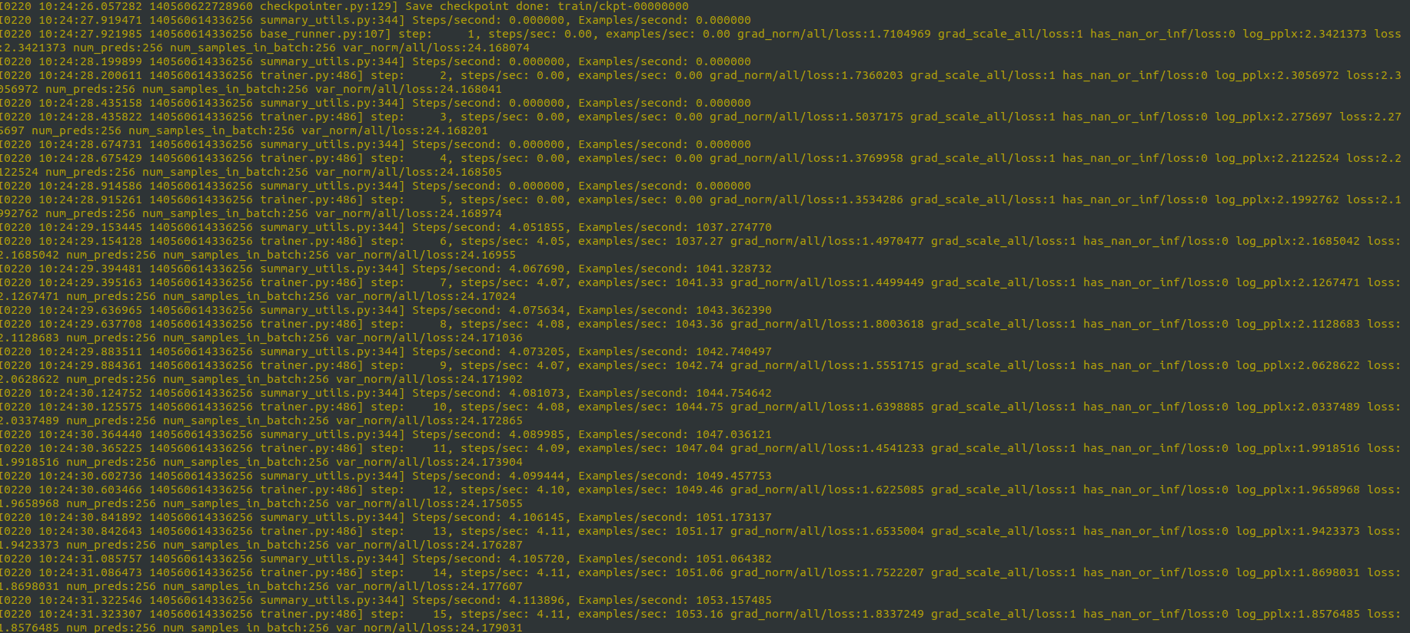
Logs and results
Loss

Slide 22
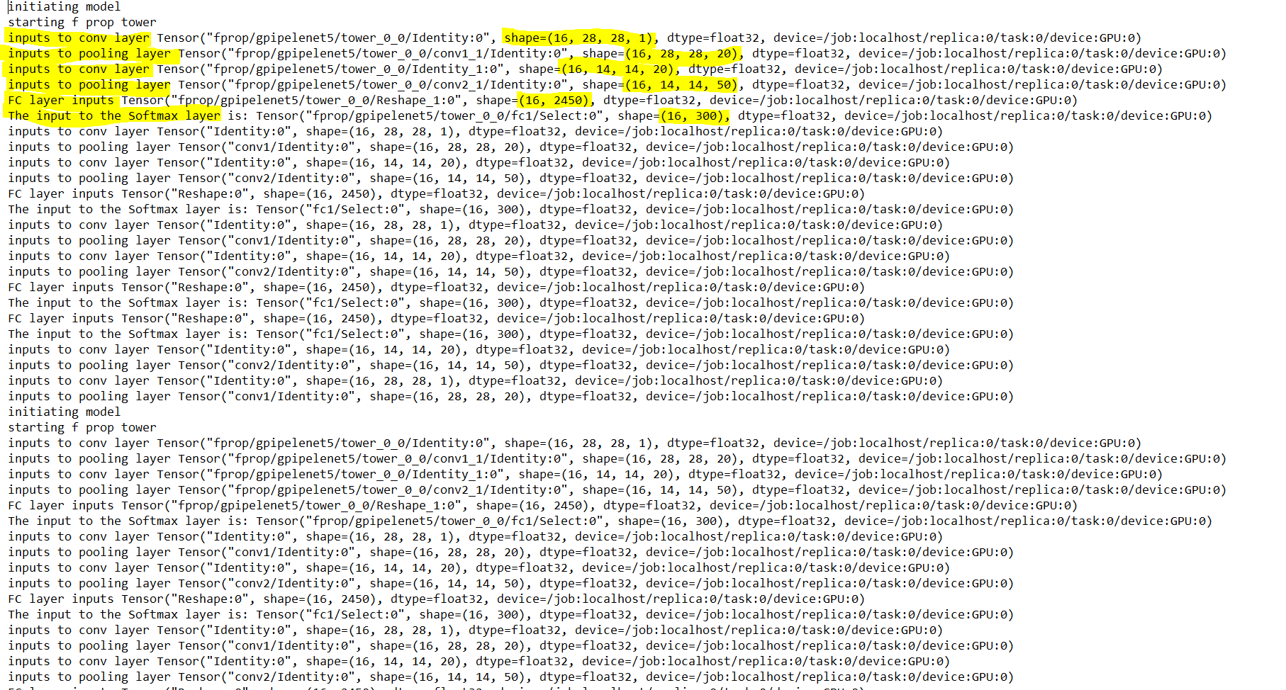
Logs and results
Verifying input sizes to each layer

Slide 23
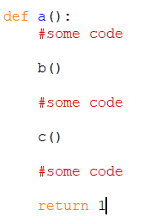
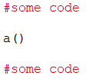
Explanation of earlier measurement method
Consider the following scenario
It is necessary to measure the execution time of function a(), along with the split times of functions b() and c()

Slide 24
This can be done using shared arrays: one for storing the timestamps (tsmArr), and the other to store the corresponding message (msgArr)
Difference between the timestamps before and after execution of the function is taken as exec time.
Timestamp before execution
Timestamp after execution

Slide 25
Similarly, timestamps before the execution and after the execution of the functions b() and c() are also stored.
Other timestamps to be stored

Slide 26
During the process of execution, we’ll obtain the following values for tsmArr and msgArr
tsmArray [t1, t2, t3, t4, t5, t6]
msgArray [start a, start b, finish b, start c, finish c, finish a]
t1
t2
t3
t6
t4
t5

Slide 27
Traverse the arrays from left to right. Whenever a “start” message is encountered, push the timestamp onto a stack, whenever a ‘finish” msg is encountered, take the difference with timestamp at the top, and pop the stack.
tsmArray [t1, t2, t3, t4, t5, t6] (for reference)
msgArray [start a, start b, finish b, start c, finish c, finish a]
Initially stack : [ ]
After t1: stack : [ t1 ]
After t2 : stack : [t1 t2]
Element at stack top

Slide 28
tsmArray [t1, t2, t3, t4, t5, t6](for reference)
msgArray [start a, start b, finish b, start c, finish c, finish a]
Stack : [t1 t2]
Upon encountering t3, i.e. a “finish b” timestamp:
Taking difference between t3 and element at stack top (t2), we get the execution time for b( ). Then we pop the stack
Stack is now [t1] (because t2 has been popped)
After encountering “start c”, t4 is pushed. Stack [t1, t4]
After “finish c”, stack is again [t1]
On encountering “finish a”, the difference (t6 – t1) is stored as execution time of a(), and stack is popped. i.e. stack = [ ]

Slide 29

Explanation for the 3 stages in FProp
First, the expected outputs are calculated (Why ?)

Slide 30
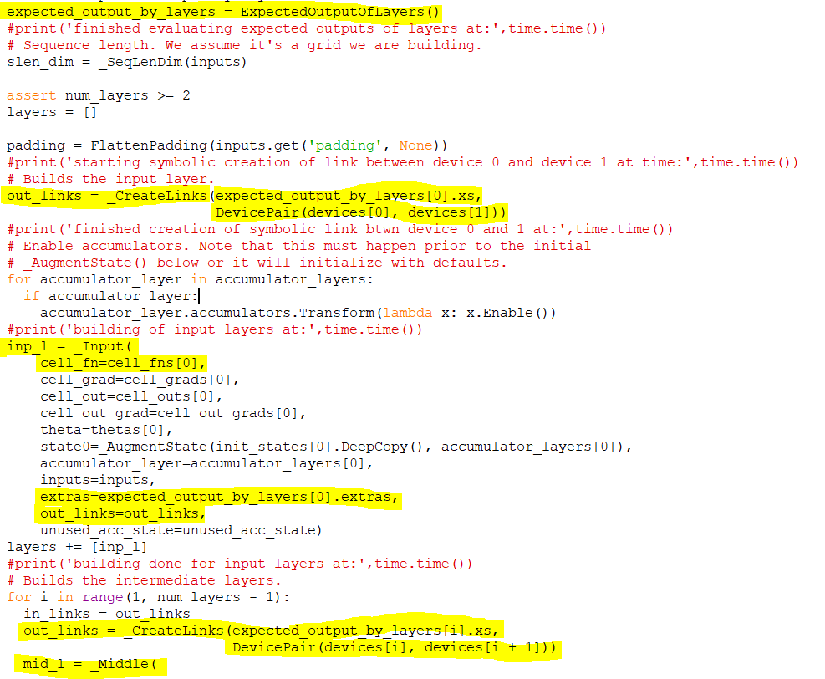
Estimate dtypes and shapes of each layer output
Device linking done based on expected outputs

Slide 31
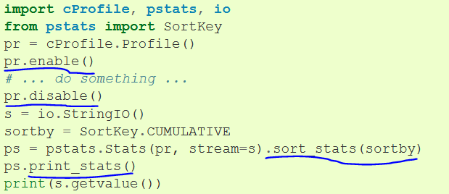
Using cProfile, pyInstrument or cuda profilers
Minimal modification to library code
Overhead does not increase linearly with program size
Easy to enable and disable profiling for sections of code

Slide 32
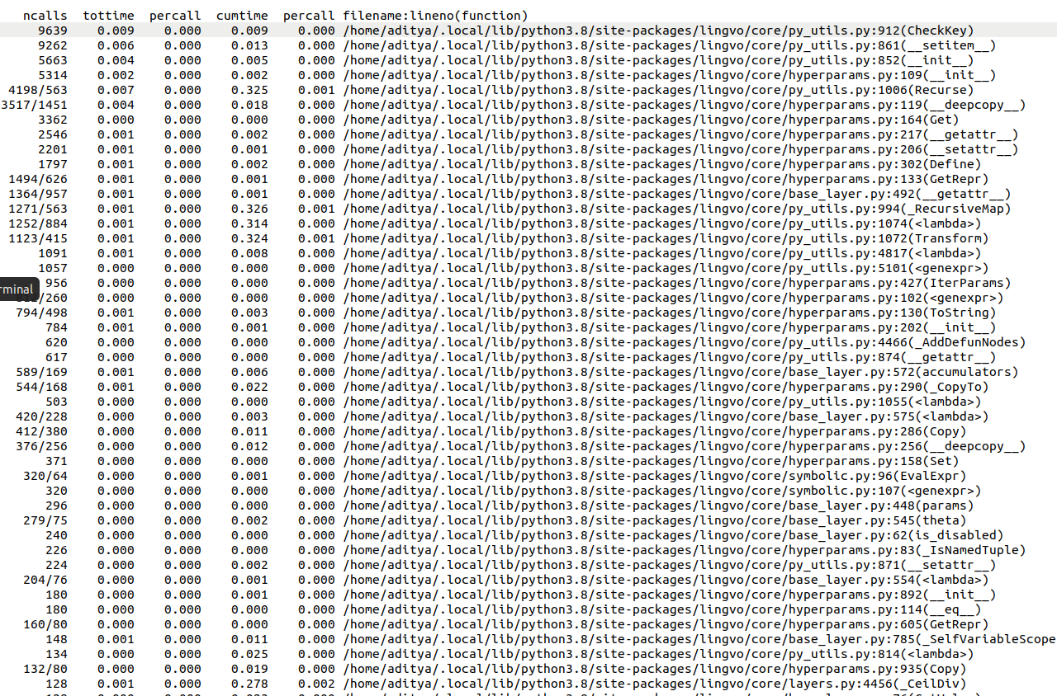
Sample output from profiler

Slide 33
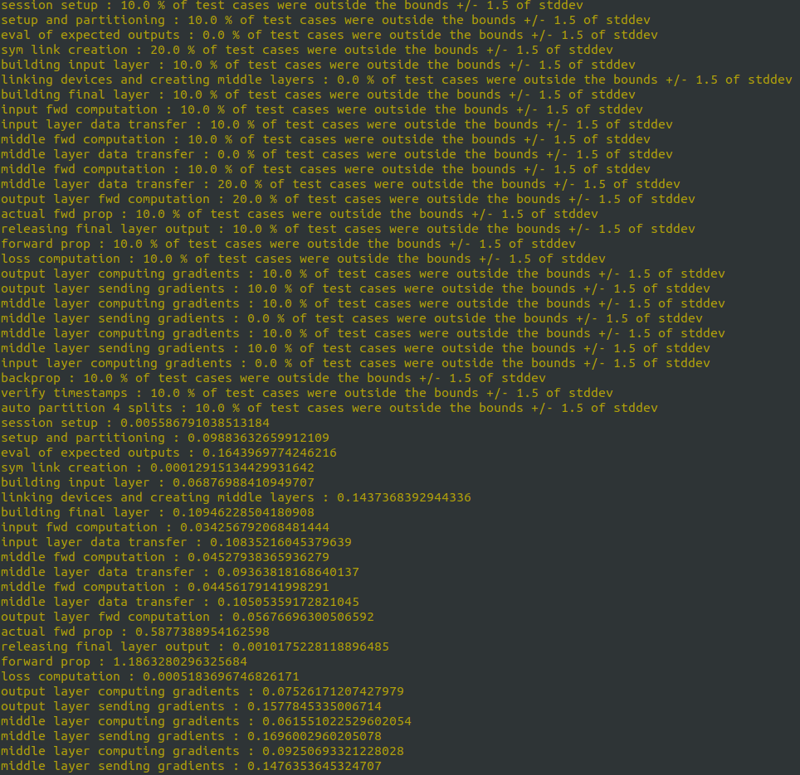
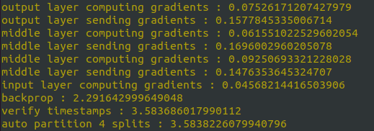
Preliminary test results

